Slide 1
The Impact of Molecular Testing on Therapeutic Decisions in Ovarian Cancer
Michael Birrer, MD, PhD
Professor of Medicine, Harvard Medical School
Director Gynecologic Medical Oncology
Massachusetts General Hospital Boston, Massachusetts, United States

Slide 2
Ovarian Cancer The Clinical Problem
250,000 women diagnosed yearly worldwide
75% patients present with advanced stage disease
80% respond to chemotherapy
Vast majority of patients relapse and eventually develop drug resistant disease
Minimal increase in overall survival over last 30 years
14,000 deaths yearly
Highest case fatality rate for gynecologic cancers in the world
All ovarian cancers treated with surgery/chemotherapy

Slide 3
Impact of Molecular Analysis
Identifying Unique Diseases and Their Pathways

Slide 4
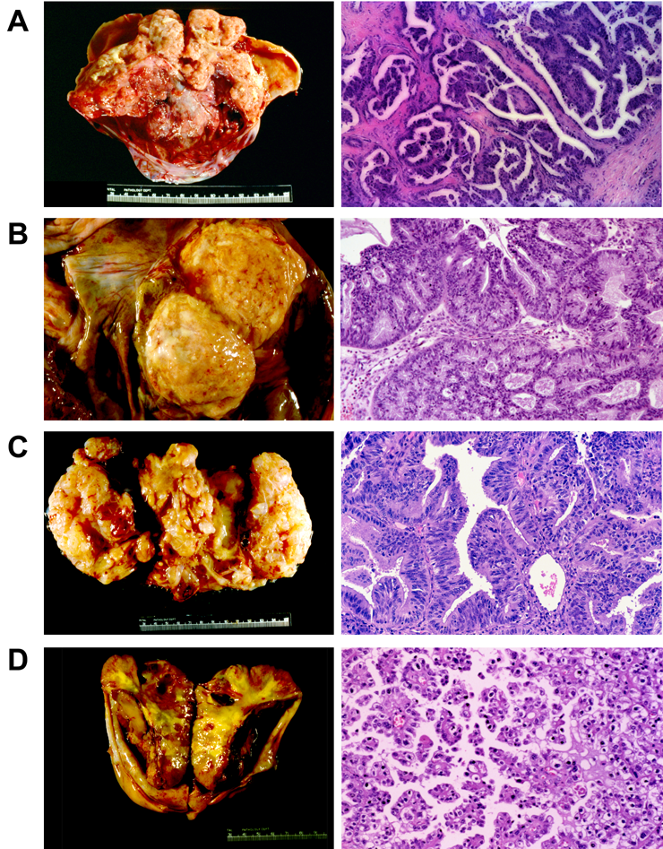
Ovarian Cancers
Serous
A disease of genomic instability
Mucinous
A disease of aberrant RAS pathway signaling
Endometrioid
A disease of aberrant PTEN, PI-3K, AKT signaling
Clear cell
A disease of ARID1A

Slide 5
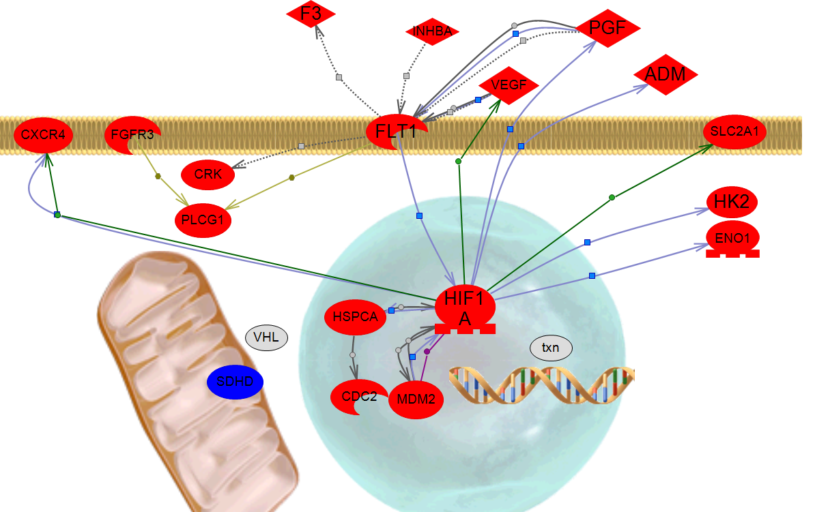
Clear Cell Ovarian Cancer Has Unique Targetable Pathways
Angiogenesis
Cell migration
Glycolysis
HIF1alpha degradation
Cell cycle progression

Slide 6
Clear Cell Specific Trials
GOG0254 A Phase II Evaluation of SU11248 (Sunitinib Malate) in the Treatment of Persistent of Recurrent Clear Cell Ovarian Carcinoma (John K Chan)
GOG0268 A Phase II Evaluation of Temsirolimus (CCI-779) (NCI Supplied Agent: 683864, IND #61010) in Combination With Carboplatin and Paclitaxel Followed by Temsirolimus Consolidation as First-line Therapy in the Treatment of Clear Cell Carcinoma of the Ovary (John H Farley)

Slide 7
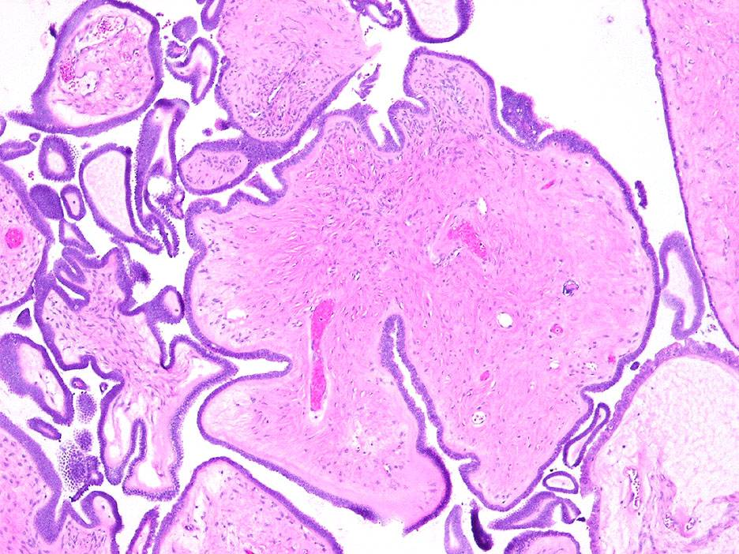
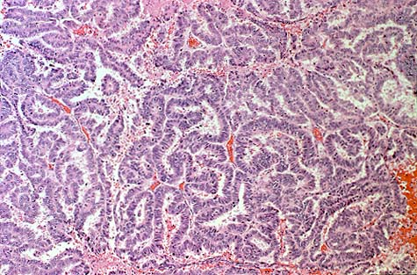
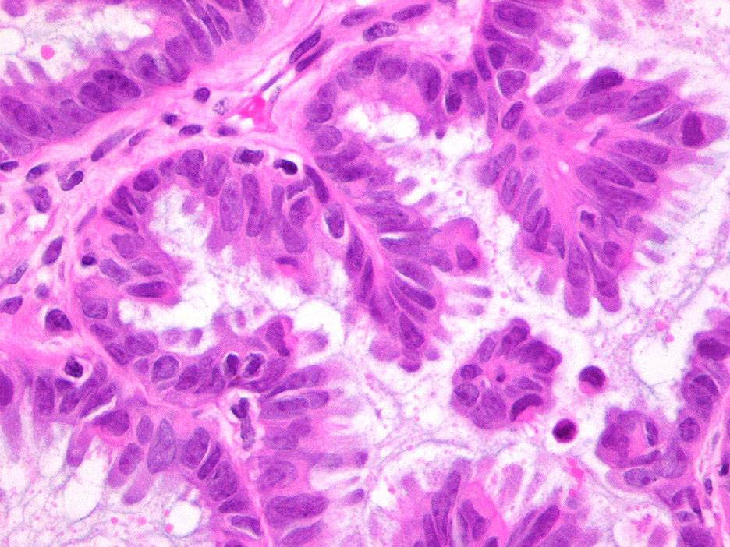
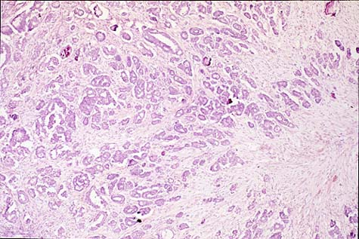
Papillary Serous Ovarian Cancer
(40x Magnification)
(40x Magnification)
Low-malignant potential (LMP)
Invasive carcinoma

Slide 8
Ovarian Cancer
Papillary serous ovarian tumors
High grade
P53-
P53+
Normal cells
LMP/low grade
B-RAF, RAS
Bonome T, et al. Cancer Res. 2005;65(22):10602-10612.

Slide 9
A Phase II Trial of AZD6244 in Women With Recurrent Low-Grade Serous Carcinoma of the Ovary or Peritoneum: A Gynecologic Oncology Group Study
Farley J, et al. Lancet Oncol. 2013;14(2):134-140.
Notes:
6

Slide 10
MAPK Pathway Inhibition Is Effective for Low Grade Tumors
 | 1 prior chemo treatment, % | >3 prior chemo treatment, % | Stable disease, % | Median PFS, months
MDACC¹ | 28 | 14 | 60 | 7.25
GOG239 | 19 | 57 | 65 | 11
Exhibits considerable activity with minimal toxicity in recurrent low-grade serous tumors
The 15% response rate is 5 times that observed for cytotoxic chemotherapy in the setting of recurrent low-grade serous tumors
These results warrant further evaluation of inhibitors of the MAPK pathway in low-grade serous ovarian cancers
1. Gershenson DM, et al. Gynecol Oncol. 2009;114(1):48-52.

Slide 11
pERK Correlates Better With Response
Tumor response by pERK positivity
Unpublished data.
Notes:
Mean H score of 108 was observed and used to segregate tumors into pERk positive and negative
Of the 34 patients who had the mutation analyses done: - 28(82%) were tissue from primary tumor - 2(6%) were tissue from metastatic tumor - 4(12%) were tissue from recurrent/persistent tumor

Slide 12
What About High Grade Serous Cancers?

Slide 13
The Cancer Genome Atlas (TCGA) Overview
Large amounts of genomic/epigenomic abnormalities
Few high frequent mutations except p53 and BRCA
Multiple areas of chromosomal gain
Containing 100s of genes
Multiple areas of relatively common chromosomal loss
Containing 100s of gene
Many hypermethylated genes
4 transcriptional cluster patterns
Transcriptional subtypes not linked strongly to survival
3 microRNA subtypes
Loosely linked to transcriptional cluster

Slide 14
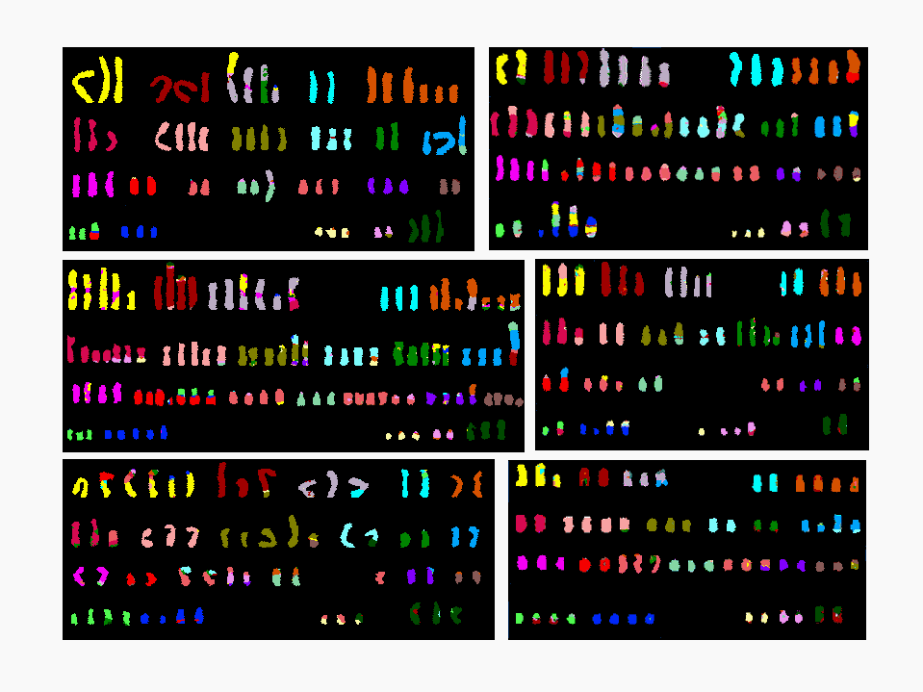
B
1 2 3 4 5
6 7 8 9 10 11
12 13 14 15 16 17 18
19 20 21 22 X
D
1 2 3 4 5
6 7 8 9 10 11 12
13 14 15 16 17 18
19 20 21 22 X
F
1 2 3 4 5
1 2 3 4 5
12 13 14 15 16 17 18
Notes:
14
Accurate classification has enabled the gnes critical to their pathogenesis
Although no immediate impact, there is no

Slide 15
In a Tumor With Genomic Instability Can We Identify Prognostic or Predictive Signatures?

Slide 16
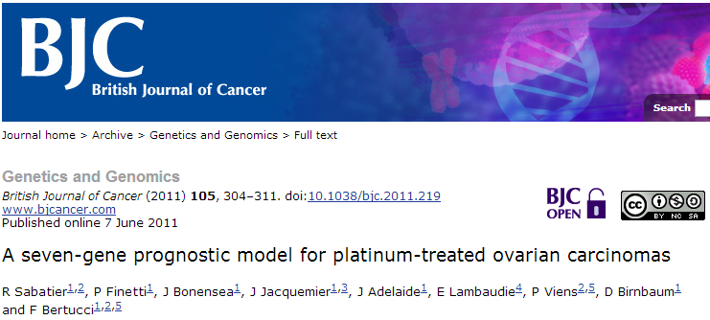
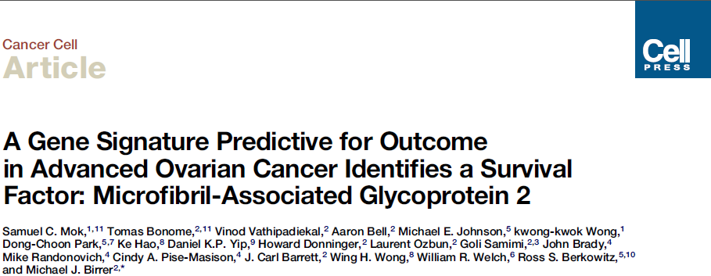
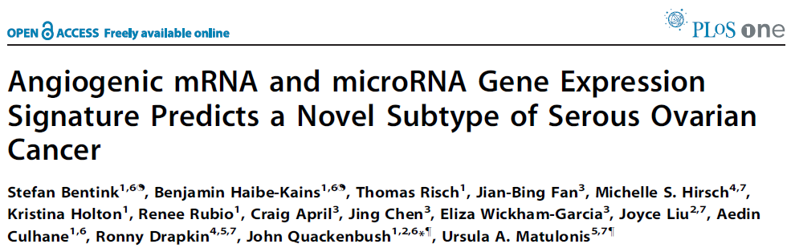
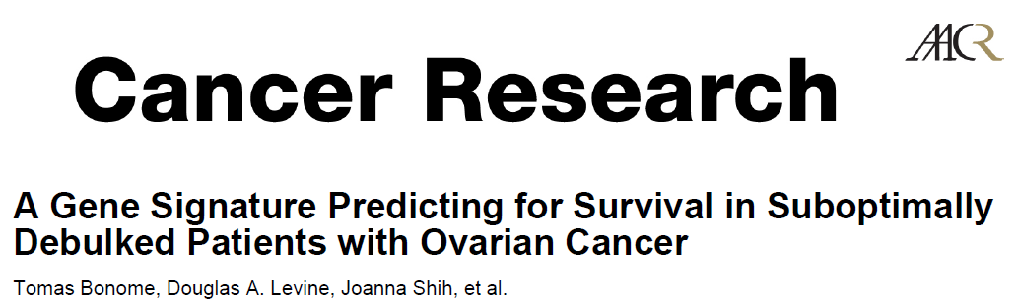
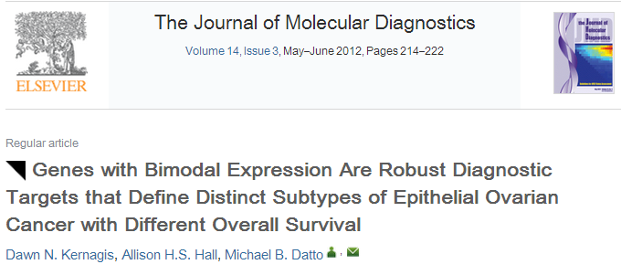
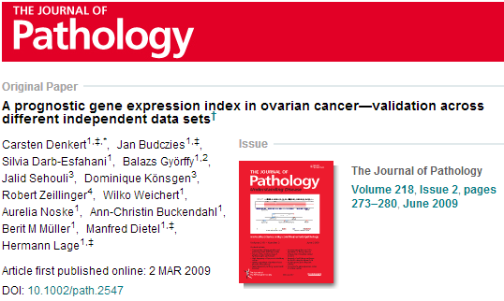

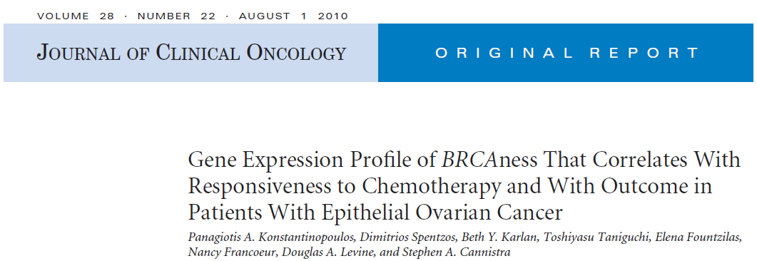
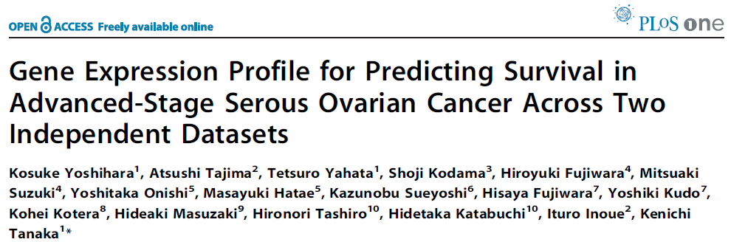
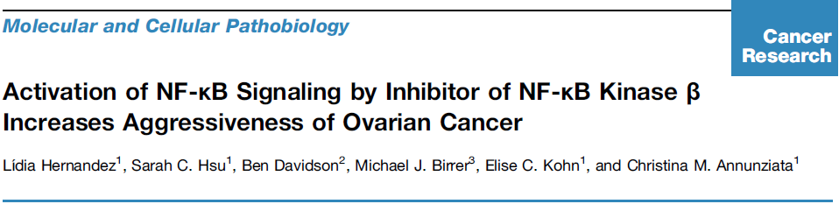
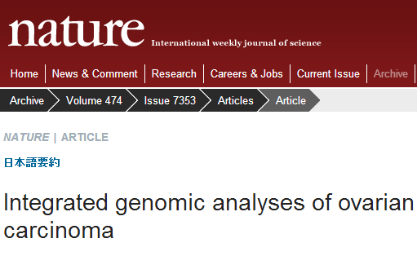
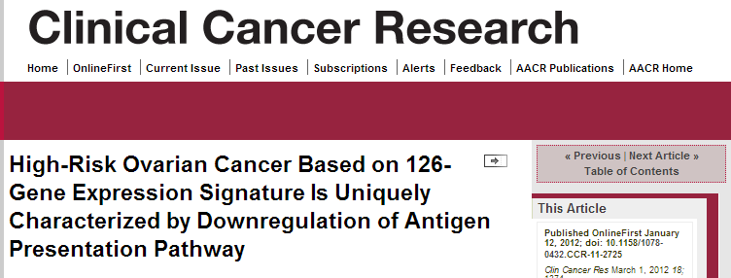
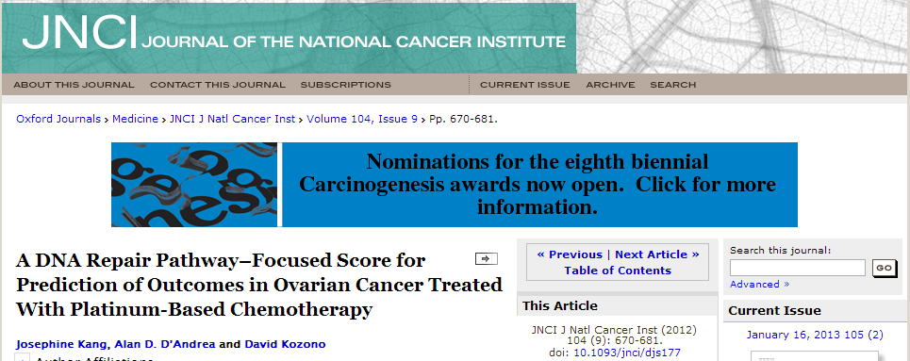
Prognostic Gene Signatures of Ovarian Cancer
Notes:
As a result, one could almost say the literature is littered with prognostic gene signatures for ovarian cancer, and diverse data and methods make these difficult to compare or use in a clinically meaningful way.

Slide 17
Prognostic Gene Signatures of Ovarian Cancer
Objectives:
Assess the reproducibility of published prognostic gene expression models
Evaluate published models using publicly available data
Improve on models using all publicly available data
Notes:
As a result, one could almost say the literature is littered with prognostic gene signatures for ovarian cancer, and diverse data and methods make these difficult to compare or use in a clinically meaningful way.

Slide 18
Meta-Analysis Overview
Literature review
Prognostic models
Database of curated gene expression
101 candidate papers
Five review papers
Standardized clinical annotation and gene ID
23 studies, 2,908 samples
Inclusion criteria
Inclusion criteria
Training sample size >40
Focus on late-stage serous
Multivariate model
Continuous risk score
Claims to predict survival
Possible to reproduce model
Sample size >40
Primary tumors
Overall survival available
Events (deaths) >15
Late stage, high grade tumors
Serous subtype
14 prediction models implemented
100 pages documentation
survHD bioconductor package
10 datasets, 1455 samples
curatedOvarianData bioconductor package
Notes:
The meta-analysis itself borrows ideas from the traditional meta-analysis that is familiar for synthesizing the results of clinical trials or health studies, but differs in some important ways. <click> It similarly begins with a systematic literature review based on defined search terms and time period plus review papers. <click> Inclusion and exclusion criteria are defined precisely to limit the search to plausible and relevant prognostic signatures, claiming to be prognostic for late-stage serous disease, providing risk predictions on a continuous scale and based on enough samples to be plausible. This final point is an important one, we had to be able to reproduce the model sufficiently to be able to apply it to new datasets, and this is very different from a traditional meta-analysis which would be considering for example a single treatment, rather than an algorithm <click>. This search resulted in 14 prognostic signatures, representing the major efforts to refine prognosis and understand the biological basis of prognosis for ovarian cancer over the past 5 years. We documented exactly how each model was reproduced, and provided evidence of the faithfulness of our re-implementation by reproducing published results, in a 100-page document showing methods and results for all 14 signatures. We also had to create a framework in which to implement these models consistently, and use them to make predictions with new data, which resulted in the survHD package.
<click> I already described the database, which <click> allowed creation of simple filter rules to narrow the database to the late-stage, high-grade samples we are interested in, with overall survival known and in sufficient sample size, providing nearly 1,500 samples from 10 studies. It’s worth pointing out that this is three times the number of samples available from the largest ovarian cancer study to date, the multi-million dollar Cancer Genome Atlas consortium project.

Slide 19
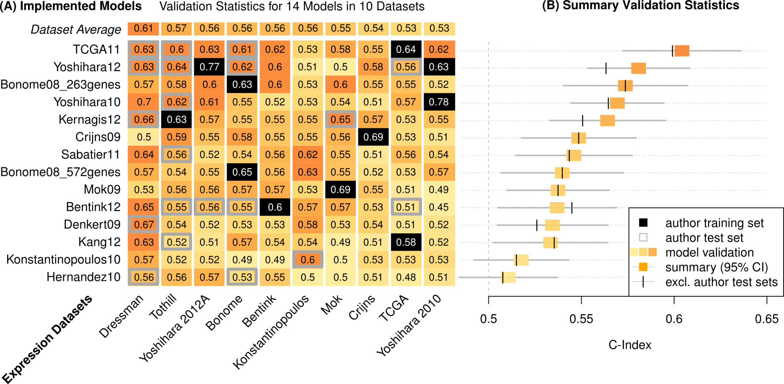
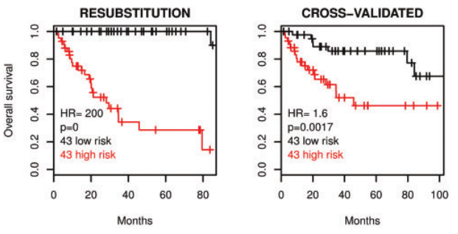
Assessment of Prognostic Signatures
C-Index = Pr(g(Z₁)>g(Z₂) | T₂>T₁)
T₁, T₂ = times to death of two patients
g(Z₁), g(Z₂) = predicted risk scores
C = 0.5 expectation for random prediction
C = 1 if the exact order of all deaths is predicted
14 prognostic signatures
Kaplan-Meier estimate
Study
Survival
10 microarray datasets
Waldron L, et al. J Natl Cancer Inst. 2014;106(5).
Time
Notes:
With this groundwork done, the actual analysis was easy by comparison, and the most difficult part was finding ways to visualize so much analyses compactly. This is both a figure and a table, and it summarizes the performance of all major ovarian cancer prognostic signatures published in a 5-year period – it’s a lot take in but we’ll walk through it. First I should explain the C-Index and orange shading – C-Index represents the accuracy of a single model in a single datasets: it’s 0.5 if the predictions are just as good as a coin flip for predicting whether one patient will die before another, and 1 if the model correctly predicts the order in which all deaths occur.
<click> this represents the prediction accuracy of 14 models in each of 10 datasets, and each cell provides the level of information that is represented in a Kaplan-Meier plot, that is, the ability of a model to discriminate patient prognosis in a single dataset. <click> One row represents validation of a single signature on all available studies, or a meta-analysis that would be represented traditionally by a forest plot. <click> The black squares indicate data used to train a model, so you’ll notice their values are higher than other squares. <click> and the grey boxes show datasets used by a signature’s authors for independent validation of that signature, and in theory should be no better or worse than the other validations.
1 or a few squares here encapsulate the findings of most publications. Explain training, author test, independent test sets.

Slide 20
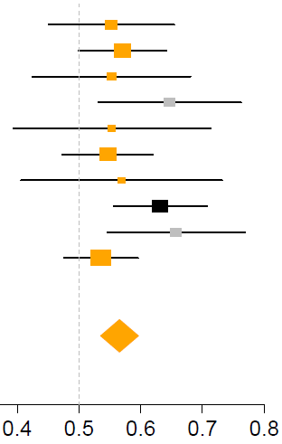
Assessment of Prognostic Signatures
C-Index = Pr(g(Z₁)>g(Z₂) | T₂>T₁)
T₁, T₂ = times to death of two patients
g(Z₁), g(Z₂) = predicted risk scores
C = 0.5 expectation for random prediction
C = 1 if the exact order of all deaths is predicted
14 prognostic signatures
Forest plot
Study
10 microarray datasets
Waldron L, et al. J Natl Cancer Inst. 2014;106(5).
C-Index
Notes:
With this groundwork done, the actual analysis was easy by comparison, and the most difficult part was finding ways to visualize so much analyses compactly. This is both a figure and a table, and it summarizes the performance of all major ovarian cancer prognostic signatures published in a 5-year period – it’s a lot take in but we’ll walk through it. First I should explain the C-Index and orange shading – C-Index represents the accuracy of a single model in a single datasets: it’s 0.5 if the predictions are just as good as a coin flip for predicting whether one patient will die before another, and 1 if the model correctly predicts the order in which all deaths occur.
<click> this represents the prediction accuracy of 14 models in each of 10 datasets, and each cell provides the level of information that is represented in a Kaplan-Meier plot, that is, the ability of a model to discriminate patient prognosis in a single dataset. <click> One row represents validation of a single signature on all available studies, or a meta-analysis that would be represented traditionally by a forest plot. <click> The black squares indicate data used to train a model, so you’ll notice their values are higher than other squares. <click> and the grey boxes show datasets used by a signature’s authors for independent validation of that signature, and in theory should be no better or worse than the other validations.
1 or a few squares here encapsulate the findings of most publications. Explain training, author test, independent test sets.

Slide 21
Assessment of Prognostic Models
Conclusions:
Most models make better predictions than random
Large, consortium studies performed best
Validation datasets can be biased
None of these models are ready for the clinic
Waldron L, et al. J Natl Cancer Inst. 2014;106(5).

Slide 22
Application of Large Database for the Generation of Clinically Relevant Signatures
Patient Survival

Slide 23
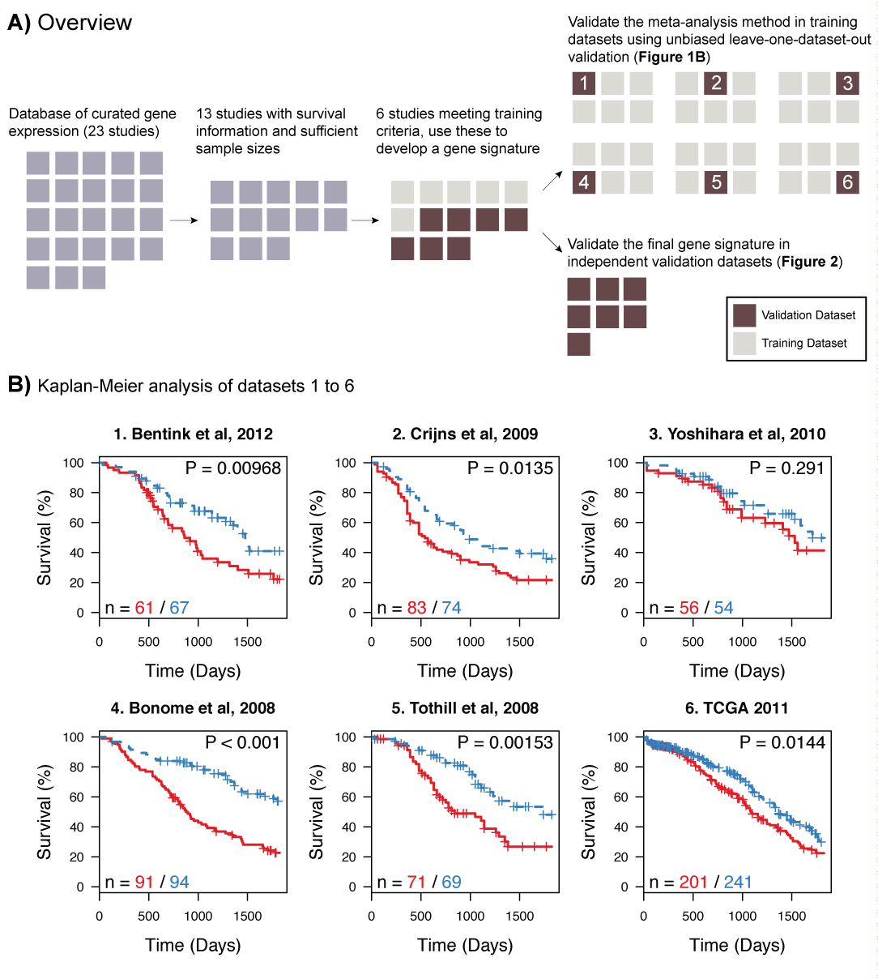
Riester M, et al. J Natl Cancer Inst. 2014;106(5).
Bentink S, et al. PLoS One. 2012;7(2):e30269. Crijns AP, et al. PLoS Med. 2009;6(2):e24. Yoshihara K, et al. PLoS One. 2010;5(3):e9615. Bonome T, et al. Cancer Res. 2008;68(13):5478-5486. Tothill RW, et al. Clin Cancer Res. 2008;14(16):5198-5208. Cancer Genome Atlas Research Network. Nature. 2011;474(7353):609-615.

Slide 24
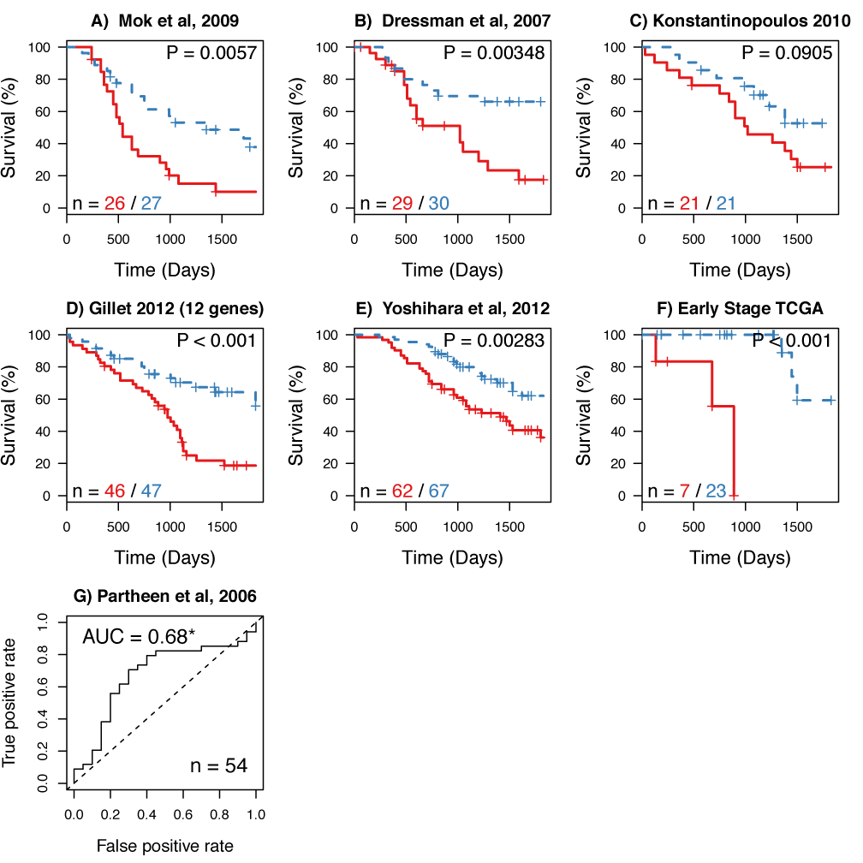
Riester M, et al. J Natl Cancer Inst. 2014;106(5).
Mok SC, et al. Cancer Cell. 2009;16(6):521-532. Dressman HK, et al. J Clin Oncol. 2007;25(5):517-525. Konstantinopoulos PA, et al. J Clin Oncol. 2010;28(22):3555-3561. Gillet JP, et al. Clin Cancer Res. 2012;18(11):3197-3206. Yoshihara K, et al. Clin Cancer Res. 2012;18(5):1374-1385. Partheen K, et al. Eur J Cancer. 2006;42(16):2846-2854.

Slide 25
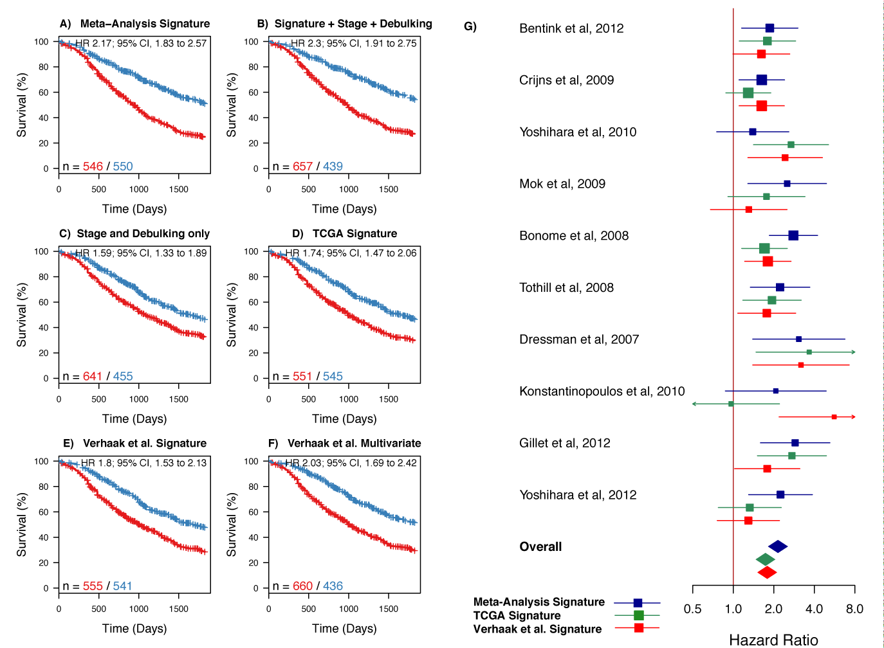
Survival Signature Performs Better Than
Known Clinical Factors and Signatures
Riester M, et al. J Natl Cancer Inst. 2014;106(5).
Bentink S, et al. PLoS One. 2012;7(2):e30269. Crijns AP, et al. PLoS Med. 2009;6(2):e24. Yoshihara K, et al. PLoS One. 2010;5(3):e9615. Bonome T, et al. Cancer Res. 2008;68(13):5478-5486. Tothill RW, et al. Clin Cancer Res. 2008;14(16):5198-5208. Dressman HK, et al. J Clin Oncol. 2007;25(5):517-525. Konstantinopoulos PA, et al. J Clin Oncol. 2010;28(22):3555-3561. Gillet JP, et al. Clin Cancer Res. 2012;18(11):3197-3206. Yoshihara K, et al. Clin Cancer Res. 2012;18(5):1374-1385.

Slide 26
Survival Signatures Still Not Clinically Relevant
Can We Generate Clinically Relevant Signatures?
Predictive Signatures

Slide 27
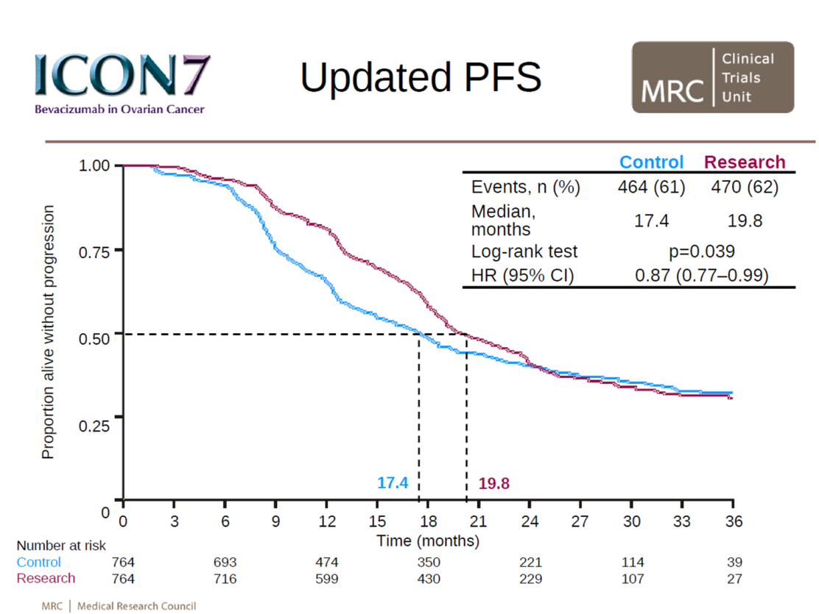
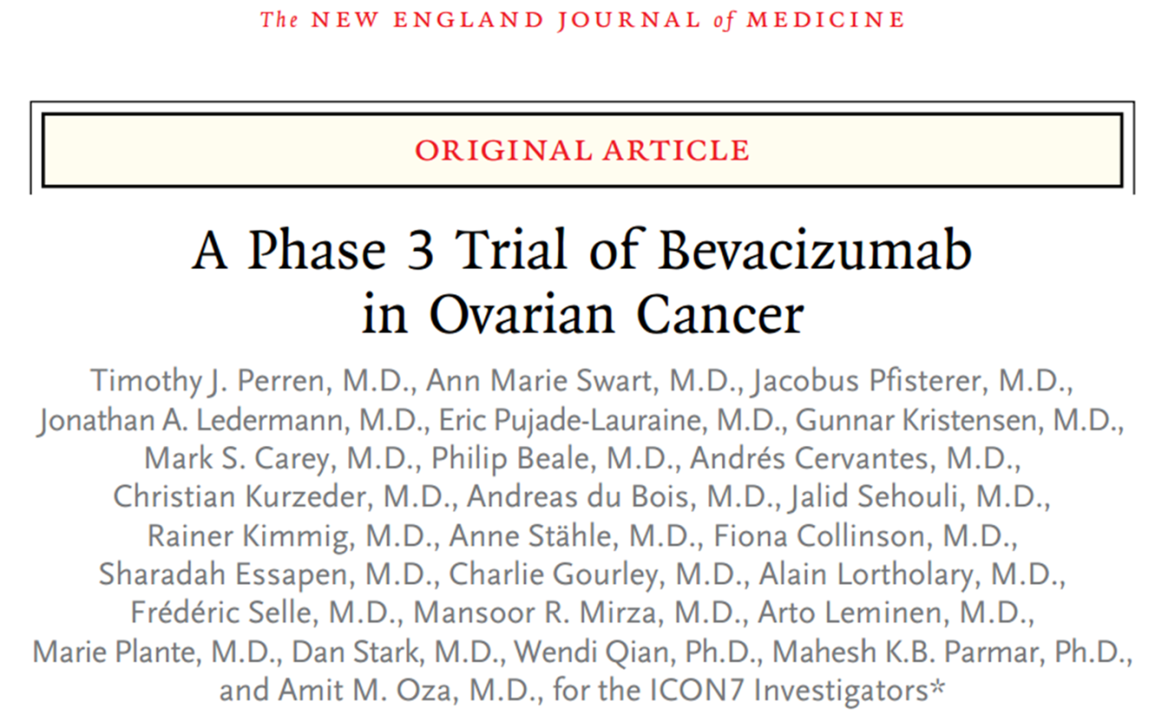
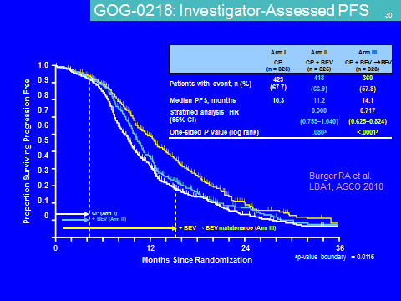
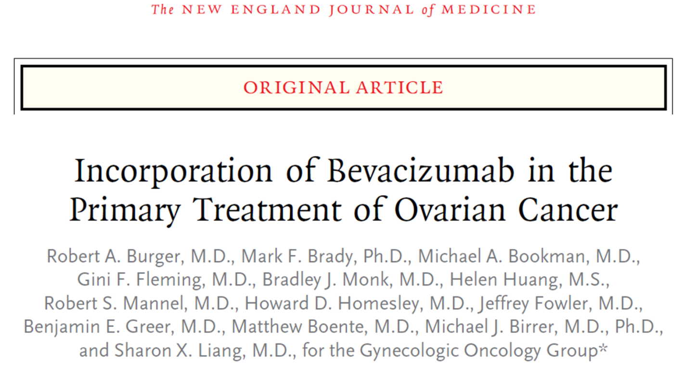
Perren TJ, et al. N Engl J Med. 2011;365(26):2484-2496. Burger RA, et al. N Engl J Med. 2011;365(26):2473-2483.

Slide 28
European Medicines Agency (EMA) granted bevacizumab a license for first line treatment of stage IIIB, IIIC and IV ovarian cancer in 2011
Bevacizumab currently licensed for the treatment of recurrent platinum resistant ovarian cancer in the USA
Perren TJ, et al. N Engl J Med. 2011;365(26):2484-2496. Burger RA, et al. N Engl J Med. 2011;365(26):2473-2483.

Slide 29
Methods
Discovery
Validation 1 (in silico)
Validation 2
Edinburgh:
387 ovarian cancers
Australia (Tothill):
285 ovarian cancers
ICON7:
375 ovarian cancers
FFPE tumour macrodissection
mRNA isolation
Expression microarray analysis (Almac Ovarian DSA®)
Independent pathology review
Analysis of high grade serous tumours

Slide 30
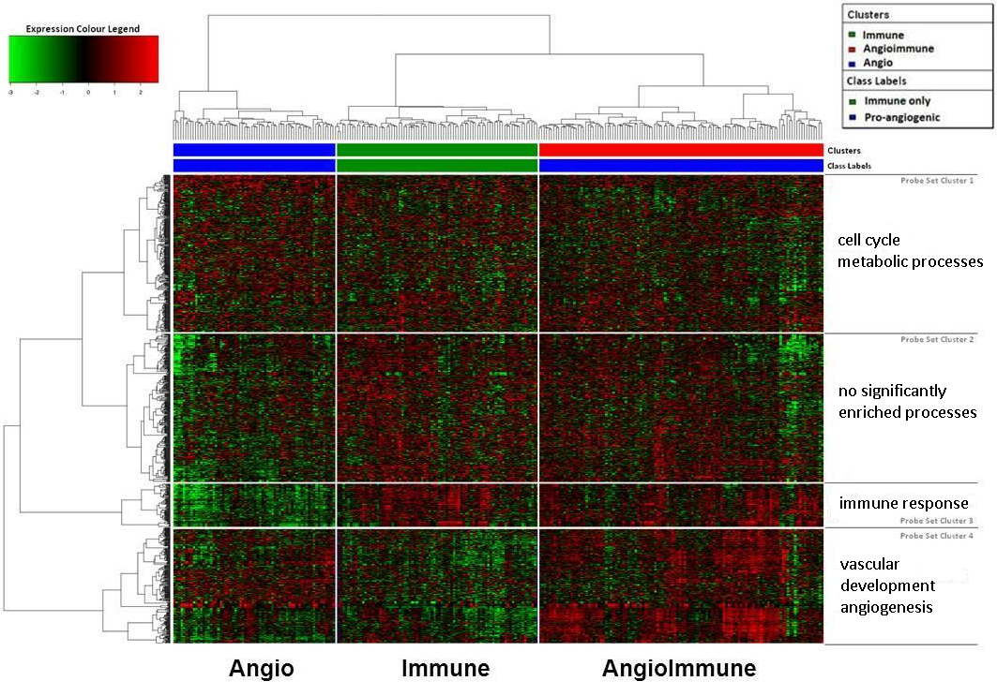
Edinburgh Dataset; Unsupervised Hierarchical Clustering
Gourley C, et al. J Clin Oncol. 2014;32(Suppl): Abstract 5502.

Slide 31
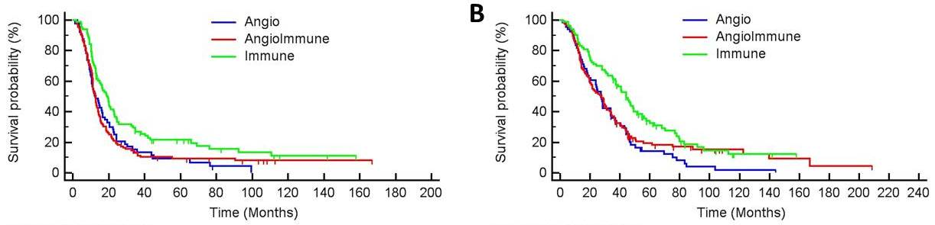
Edinburgh Dataset; Survival Analysis
Progression-free survival
Overall survival
HR 95% CI P value
Immune vs angioimmune 0.60 0.44-0.82 .002
Immune vs angio 0.64 0.45-0.92 .02
HR 95% CI P value
Immune vs angioimmune 0.58 0.41-0.82 .001
Immune vs angio 0.55 0.37-0.80 .001
Gourley C, et al. J Clin Oncol. 2014;32(Suppl): Abstract 5502.

Slide 32
Edinburgh Dataset; Unsupervised Hierarchical Clustering
25%
31%
44%
Gourley C, et al. J Clin Oncol. 2014;32(Suppl): Abstract 5502.

Slide 33
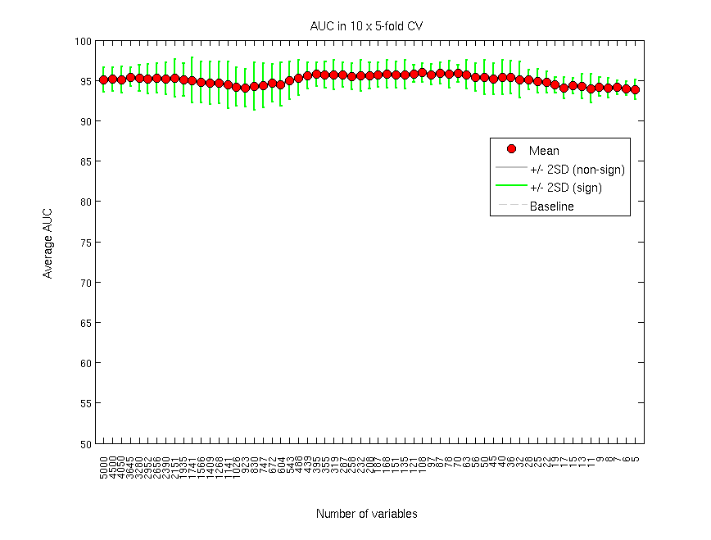
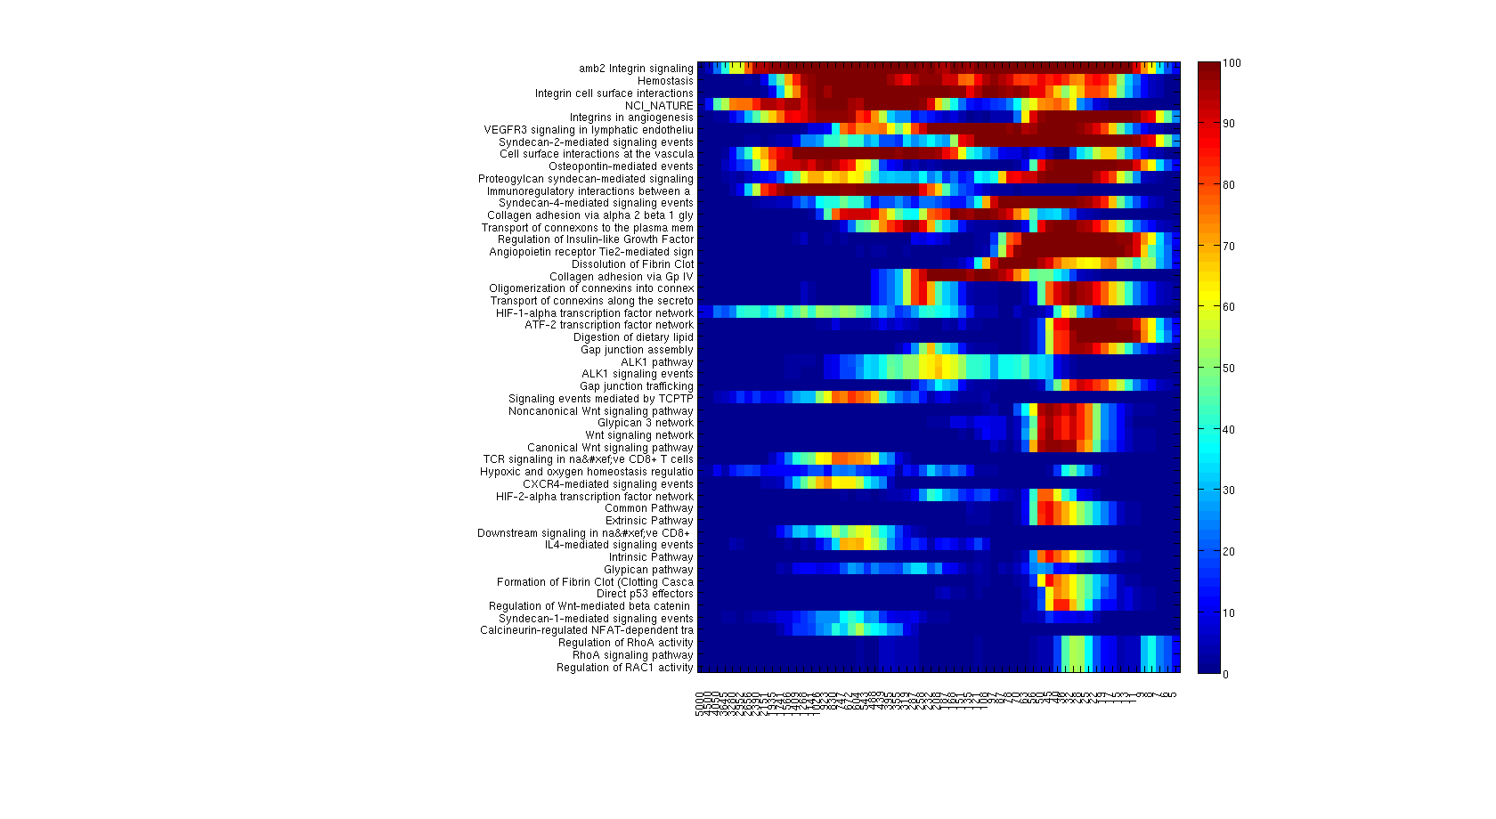
Edinburgh Dataset; Immune Subgroup Signature Generation
Data set
AUC Performance
Training
Test
Optimise model
Repeat using
different methods
Remove
Features
Rank Features
Biological Relevance
Predict test
Repeat within cross validation
Select best performing model
Build final model on whole dataset
63-gene signature developed to distinguish Immune subgroup patients from those in the angio and angioimmune subgroups.
Validate on independent data
Gourley C, et al. J Clin Oncol. 2014;32(Suppl): Abstract 5502.

Slide 34
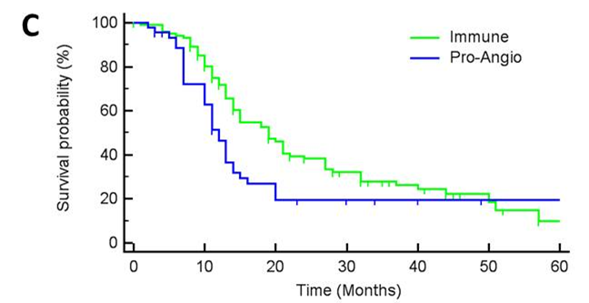
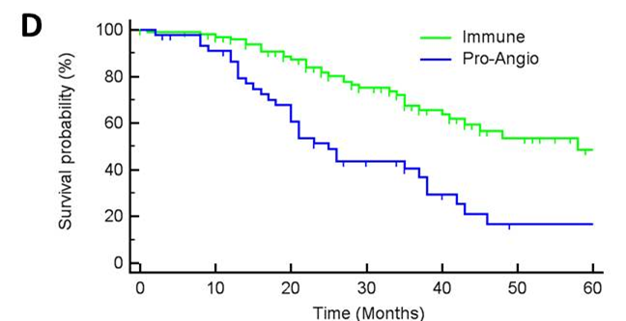
Application of Signature to Tothill Dataset
PFS
OS
Univariate: HR = 0.661 [0.439-0.996], P = .048 HR = 0.357 [0.219-0.582], P<.001
Multivariable: HR = 0.645 [0.423-0.982], P = .041 HR = 0.343 [0.206-0.571], P <.001
Gourley C, et al. J Clin Oncol. 2014;32(Suppl): Abstract 5502.

Slide 35
Application of the 63-gene Immune Signature to the ICON7 Translational Specimens
The immune molecular subtype is characterised by absence of angiogenic biology
We hypothesized that this group would not benefit from anti-angiogenic agents
The Immune assay was therefore applied to translational research samples from the ICON7 study (carboplatin and paclitaxel +/- bevacizumab)
88% power to detect interaction >2 in the predicted direction for PFS (α = 0.1, one-tail)
Gourley C, et al. J Clin Oncol. 2014;32(Suppl): Abstract 5502.

Slide 36
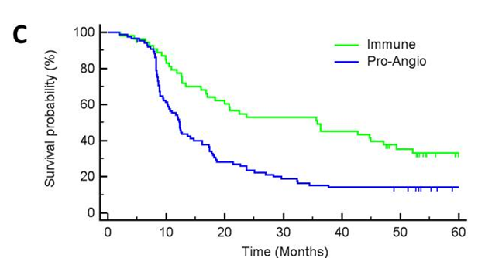
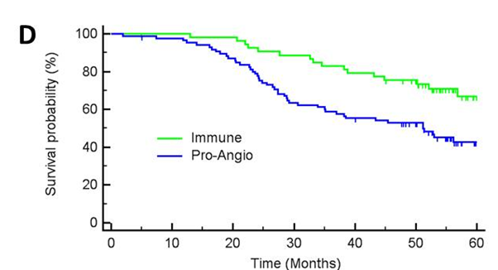
Immune Signature Prognostic Within the Control Arm of ICON7
PFS
OS
Univariate: HR = 0.47 [0.32-0.71], P<.001 HR = 0.45 [0.26-0.79], P = .005
Multivariable: HR = 0.52 [0.33-0.81], P = .004 HR = 0.53 [0.29-0.96], P = .04
Gourley C, et al. J Clin Oncol. 2014;32(Suppl): Abstract 5502.

Slide 37
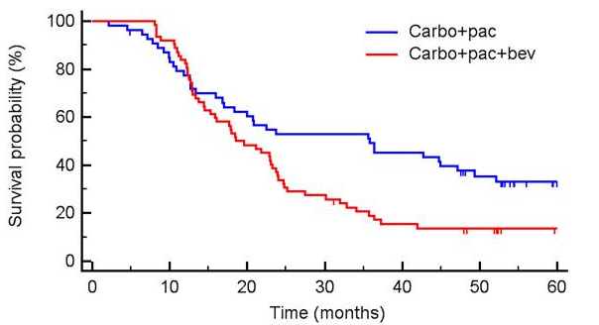
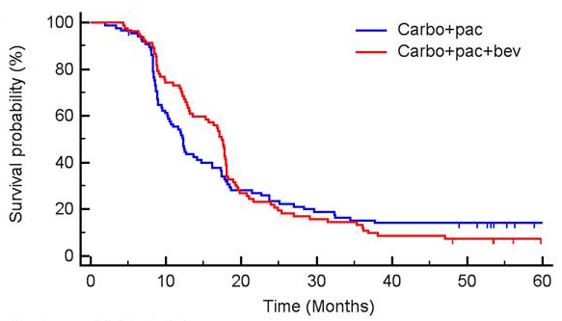
Immune Subgroup Patients Have Inferior Progression-Free Survival When Treated With Bevacizumab
Immune subgroup:
41% of ICON7 TR patients
Nonimmune (proangiogenic)
subgroup: 59% of ICON7 TR patients
Test for interaction, P = .015
 | Immune subgroup | Proangiogenic subgroup
Nonproportionality test | P = .048 | P = .003
Restricted mean PFS in months (se) | C/P 29.7 (2.2) C/P/Bev 23.8 (1.8) | C/P 18.3 (1.5) C/P/Bev 19.3 (1.3)
Diff in restricted mean PFS (95% CI) | -5.9 (-11.5 to -0.3) | 1.0 (-2.9 to 4.9)
Median PFS in months | C/P 35.8 C/P/Bev 18.5 | C/P 12.3 C/P/Bev 17.4
Gourley C, et al. J Clin Oncol. 2014;32(Suppl): Abstract 5502.

Slide 38
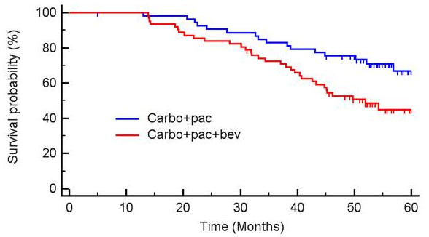
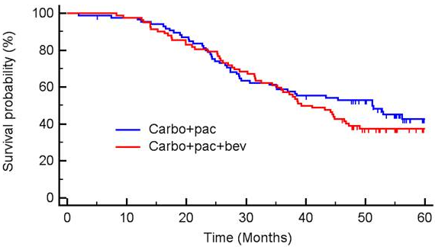
Immune Subgroup Patients Have Inferior Overall Survival When Treated With Bevacizumab
Non-immune (pro-angiogenic) subgroup
Immune subgroup
Test for nonproportionality negative in both molecular subgroups
 | Immune subgroup | Proangiogenic subgroup
Univariate | HR 2.00 (1.11-3.61), P = .022 | HR 1.19 (0.80-1.78), P = .386
 | Test for interaction, P = .075
Multivariate | HR 2.37 (1.27-4.41), P = .007 | HR 1.10 (0.73-1.66), P = .637
 | Test for interaction, P = .020
Gourley C, et al. J Clin Oncol. 2014;32(Suppl): Abstract 5502.

Slide 39
Establishment of Debulking Signature
Based upon the biologic basis of disease spread
Analyzed 1525 microarrays of primary ovarian cancers
22% suboptimal (>1CM)
Supervised analysis/signature identification
Generate pathway

Slide 40
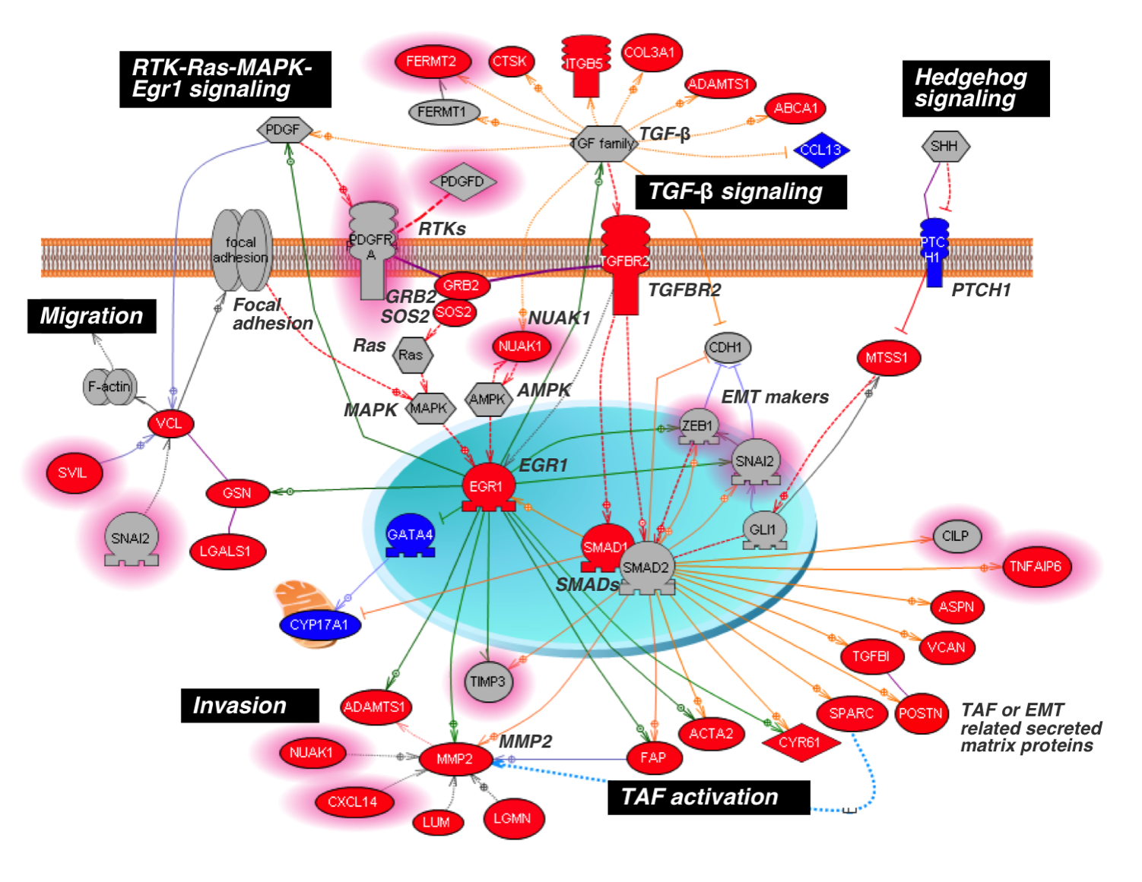
Riester M, et al. J Natl Cancer Inst. 2014;106(5).

Slide 41
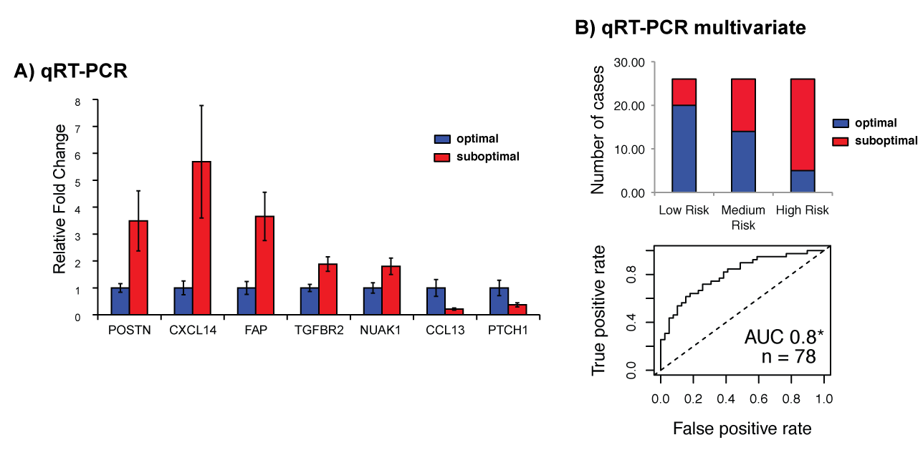
qRT-PCR of 7 Pathway Genes Validates Signature
and Provides an AUC of .8
Riester M, et al. J Natl Cancer Inst. 2014;106(5).

Slide 42
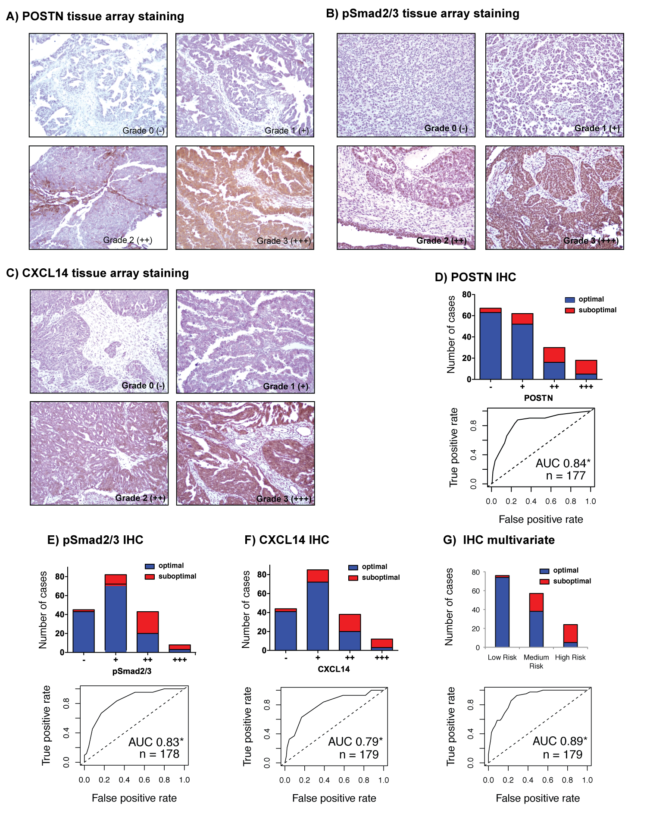
Expression of Three Proteins Provides 93% Accuracy for
Determining Sub-optimal Debulking Status
Riester M, et al. J Natl Cancer Inst. 2014;106(5).

Slide 43
Genomic Instability/HRD
Does It Provide Prognostic Versus Predictive Biomarkers?

Slide 44
Background: GOG 218 and GOG 262
 |  | GOG 218 | GOG 262
Chemotherapy arms |  | Carbo/Taxol +/- Bev, Bev maint | Carbo/Taxol q 3wk vs. Dose-dense, + Bev
Age | <40 | 22 (2.8%) | 19 (2.7%)
 | 40-49 | 108 (13.9%) | 86 (12.4%)
 | 50-59 | 242 (31.1%) | 210 (30.3%)
 | 60-69 | 262 (33.7%) | 233 (33.7%)
 | 70-79 | 136 (17.5%) | 120 (17.3%)
 | >80 | 8 (1.0%) | 24 (3.5%)
Race | White | 688 (88.4%) | 592 (85.5%)
 | Black | 28 (3.6%) | 38 (5.5%)
 | Hispanic | 32 (4.1%) | 27 (3.9%)
Stage/debulking | Stage IV | 184 (23.7%) | 217 (31.4%)
 | Optimal | 333 (42.8%) | 0 (not allowed)
Neoadjuvant |  | 0 (not allowed) | 88 (12.7%)
High grade serous histology |  | 632 (81.2%) | 556 (80.3%)
Norquist BS, et al. Presented at: Society of Gynecologic Oncology 45th Annual Meeting on Women’s Cancer; March 22-25, 2014; Tampa, Florida. Abstract 10.
Notes:
Main differences – chemo, Stage/debulking – 262 was suboptimal ONLY, NAC was allowed but was a small percentage
Age, Race, histology, not different

Slide 45
Summary of Mutation-Carriers: GOG 218 and GOG 262
258/1346 (19.2%) with loss of function mutations
28% of mutation-carriers had mutations in non-BRCA1/2 genes
N = 1346
Norquist BS, et al. Presented at: Society of Gynecologic Oncology 45th Annual Meeting on Women’s Cancer; March 22-25, 2014; Tampa, Florida. Abstract 10.
Notes:
B1: 117/1346 = 8.7%
B2: 69/1346 = 5.1%
Other: 72/1346 = 5.3%
72/258 = 27.9%

Slide 46
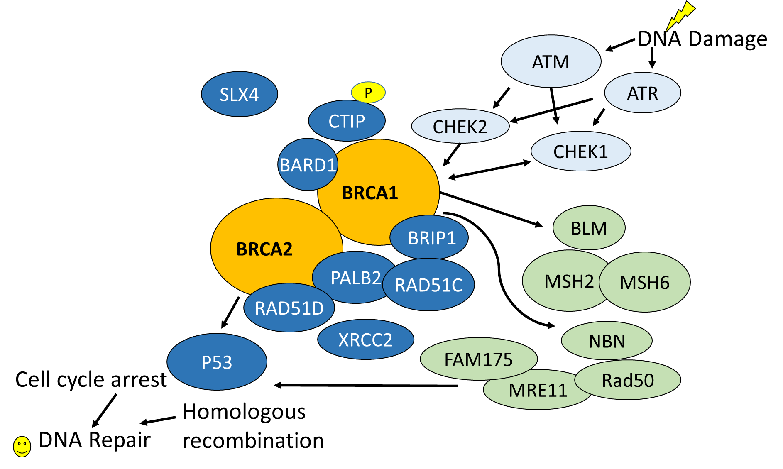
There Is More to DNA-Repair Than BRCA1/2
Orange: Walsh T, et al. Proc Natl Acad Sci U S A. 2011;108(44):18032-18037. Red: Meindl A, et al. Nat Genet. 2010;42(5):410-414. Loveday C, et al. Nat Genet. 2011;43(9):879-882. Rafnar T, et al. Nat Genet. 2011;43(11):1104-1107. Casadei S, et al. Cancer Res. 2011;71(6):2222-2229.

Slide 47
Summary of Cancer-Associated Mutations: GOG 218 and GOG 262
N = 265 mutations
in 258 women
Norquist BS, et al. Presented at: Society of Gynecologic Oncology 45th Annual Meeting on Women’s Cancer; March 22-25, 2014; Tampa, Florida. Abstract 10.
Notes:
CNVs: 14 (8 BRCA1, 1 NBN, 2 CHEK2, 1 BRIP1, 1 PALB2, 1 RAD51D) (8.5% CNVs) 14/164
CNVs: 2 BRCA1, 1 PALB2, 2 PMS2, 1 BRIP1, 1 CHEK2, 1 RAD51D 8/102 (7.8%) 22/266 = 8.3% CNVs

Slide 48
Mutation Status by Histology
Norquist BS, et al. Presented at: Society of Gynecologic Oncology 45th Annual Meeting on Women’s Cancer; March 22-25, 2014; Tampa, Florida. Abstract 10.
Notes:
Most were high grade serous, none are significantly different from HGS (using that as standard)
Adenoca, undiff also includes “other” and “serous not specified” which was 7
Mucinous left off – all WT, only 3
Clear cell other – a PALB2 and an ATM, 1 BRCA1

Slide 49
Progression-Free Survival, GOG 218
BRCA1
BRCA2
Other
WT
BRCA2 vs no mutation, P = .009
Norquist BS, et al. Presented at: Society of Gynecologic Oncology 45th Annual Meeting on Women’s Cancer; March 22-25, 2014; Tampa, Florida. Abstract 10.
Notes:
Basically BRCA2 has longest PFS, median 21.8 months vs. rest
HR adjusting for study treatment, figo stage, optimal, and performance status, mutation status sig, global test of survival time by mutation status has p=0.0498, but driven by BRCA2, which is the only one that is individually different, p = 0.009

Slide 50
Overall Survival, GOG 218
BRCA
WT
BRCA2 vs no mutation P = .0005
Norquist BS, et al. Presented at: Society of Gynecologic Oncology 45th Annual Meeting on Women’s Cancer; March 22-25, 2014; Tampa, Florida. Abstract 10.
Notes:
Again, adjusted for treatment arm, stage, residual dz, performance status, global test of survival time by mutation status sig, p<0.0017
B2: p = 0.0005, B1 p=0.09, other p =0.2

Slide 51
Genomic Instability/HRD
This Prognostic Signature May Be Predictive

Slide 52
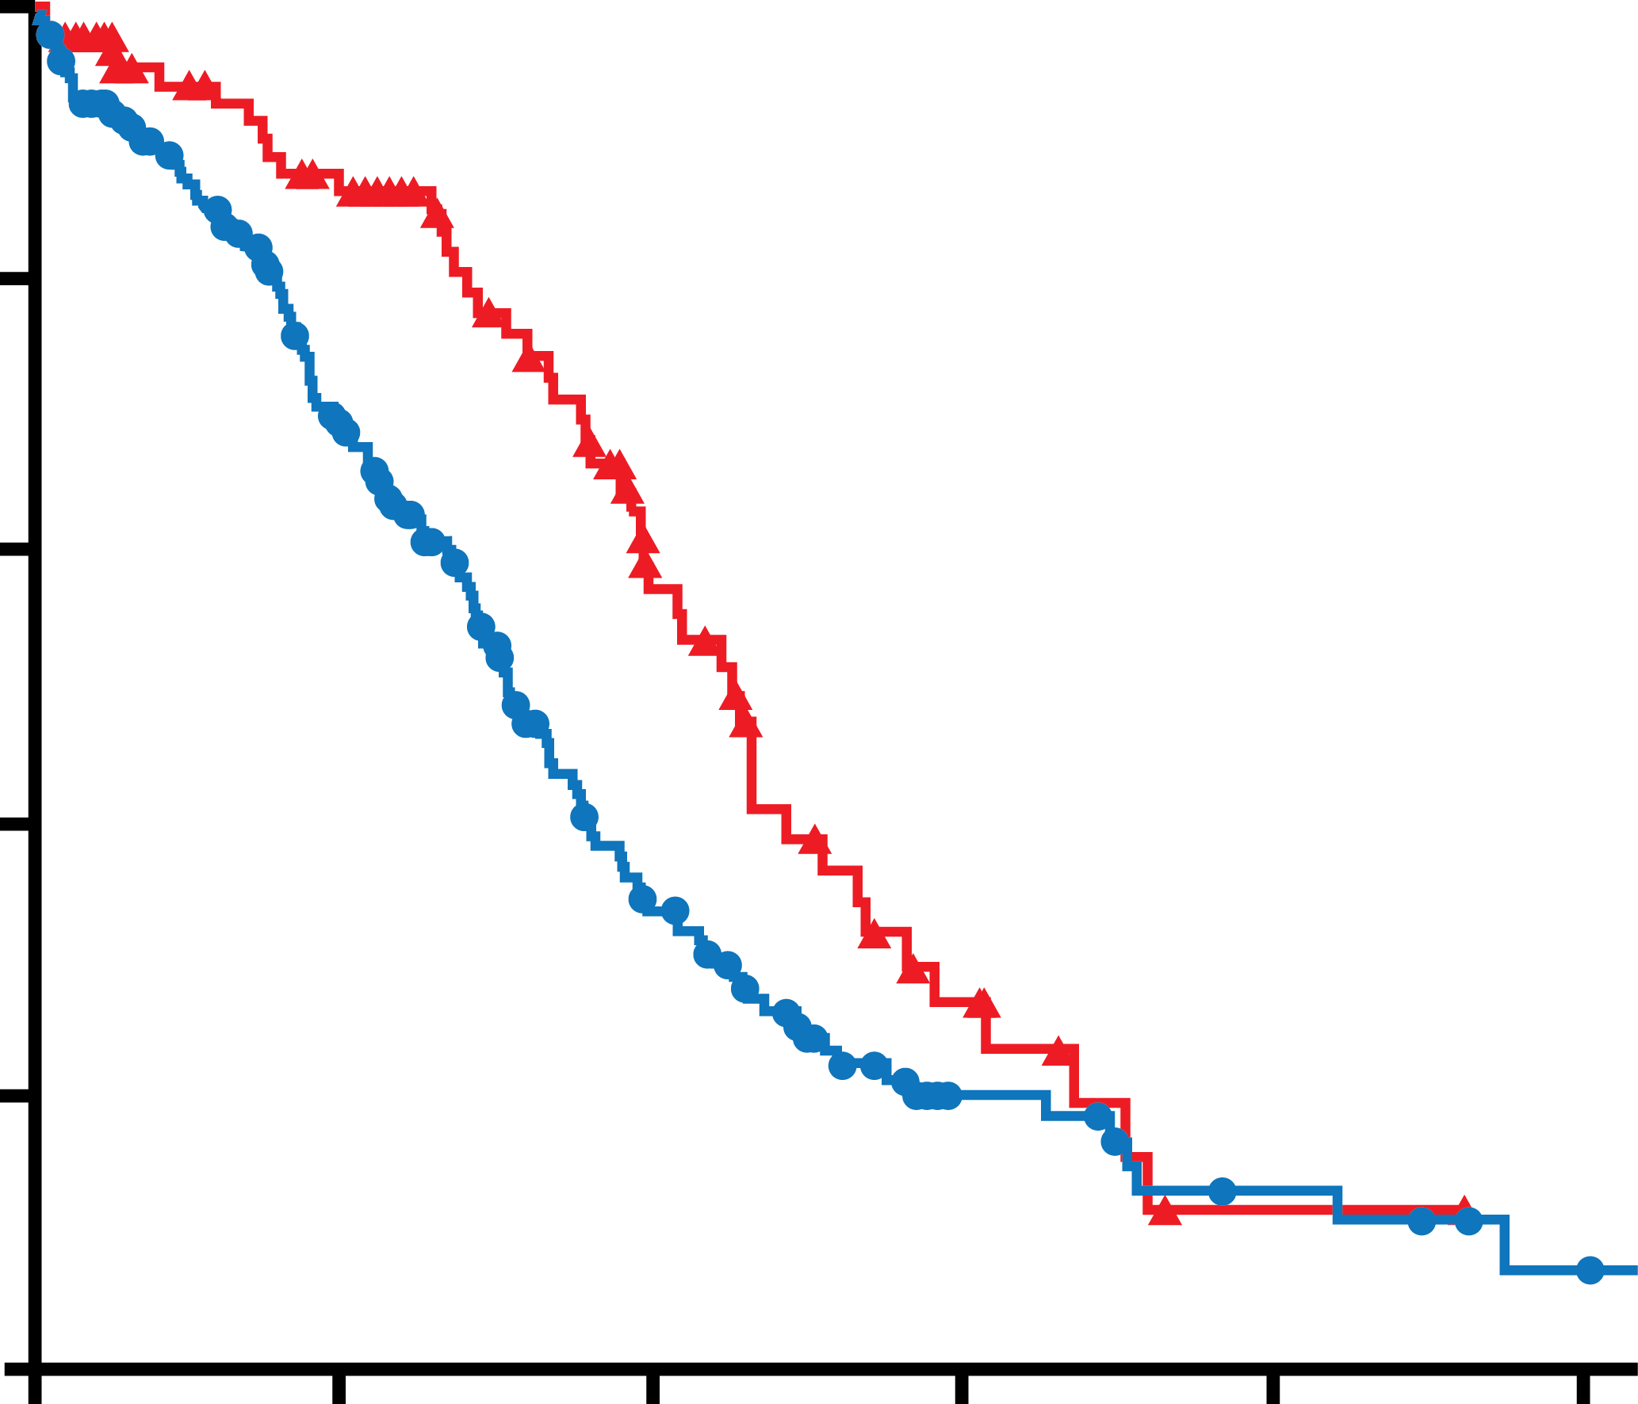
Diagnostic Development: Cutoff Defined for BRCA-Like Signature, Being Tested and Refined
TCGA and AOCS overall survival data used to develop LOH cutoff to identify
high-grade ovarian cancer patient tumors with BRCA-like signature
0.30
100
High genomic LOH (n = 97)
Low genomic LOH (n = 212)
0.25
80
0.20
Log-rank: P = .0047
Hazard ratio = 0.62
60
Log-Rank P Value (high vs low LOH groups)
Overall Survival (% probability)
Independent predictor from BRCA^{mut} status
0.15
Optimal LOH cutoff
40
0.10
0.05
20
Median overall survival: 56.4 vs 38.2 months
0
0
0
25
50
75
100
125
Genomic LOH Cutoff
Overall Survival (months)
Prospective testing of prespecified cutoff in ARIEL2 and ARIEL3
Swisher E, et al. Presented at: 26th EORTC-NCI-AACR Symposium on Molecular Targets and Cancer Therapeutics; November 18-21, 2014; Barcelona, Spain.

Slide 53
ARIEL2 Goal: Assess Rucaparib Sensitivity in Prospectively Defined Molecular Subgroups
Key Eligibility
High-grade serous or endometrioid ovarian cancer
≥1 prior platinum chemotherapy
Platinum-sensitive, relapsed, measurable disease
Adequate tumor tissue (screening biopsy and archival)
No prior PARPi
Primary Endpoint
PFS (RECIST) in:
BRCA^{mut}
BRCA-like (excludes BRCA^{mut})
Biomarker negative
600 mg BID rucaparib continuously until progression by RECIST
Secondary Endpoints
ORR (RECIST & CA-125)
Safety
Pharmacokinetics
Cap on known germline BRCA^{mut}
CA-125, cancer antigen 125 test; ORR, overall response rate; RECIST, Response Evaluation Criteria In Solid Tumors
Swisher E, et al. Presented at: 26th EORTC-NCI-AACR Symposium on Molecular Targets and Cancer Therapeutics; November 18-21, 2014; Barcelona, Spain.

Slide 54
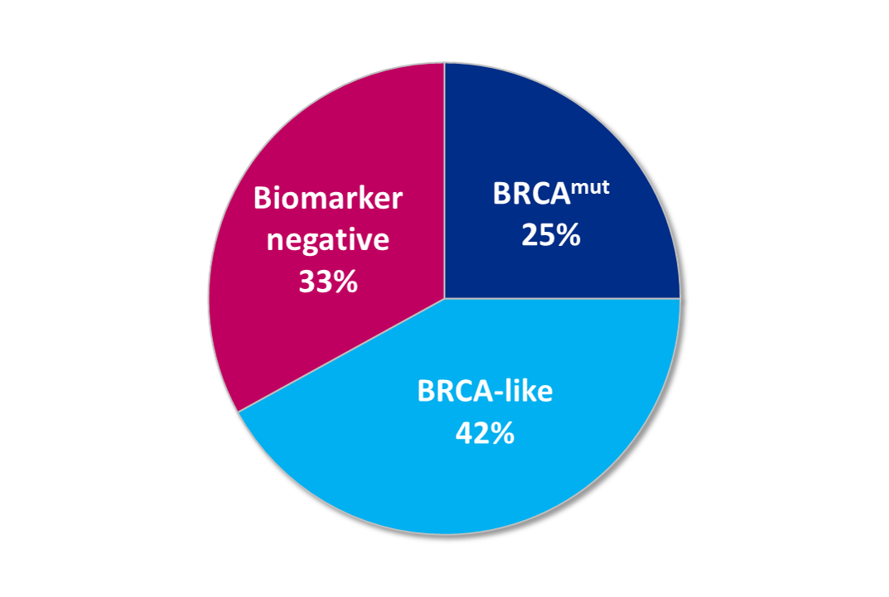
The Majority of BRCA^{wt} Patient Tumors Exhibit BRCA-Like Signature
Tumor BRCA/BRCA-like status as determined by HRD Test (N = 121)
17 germline BRCA^{mut}
12 somatic BRCA^{mut}
1 indeterminate
High genomic LOH
Swisher E, et al. Presented at: 26th EORTC-NCI-AACR Symposium on Molecular Targets and Cancer Therapeutics; November 18-21, 2014; Barcelona, Spain.
Notes:
All BRCA mutant tumors identified to date have high genomic LOH

Slide 55
Greatest Rucaparib Activity Observed in BRCA^{mut} Patients…
Robust clinical activity observed in BRCA^{mut} patients (n = 23)
61% ORR (RECIST)
70% ORR (RECIST & CA-125)
83% of patients continuing on treatment (+)
Responses observed in germline and somatic BRCA^{mut} tumors
Best target lesion response
120
Germline
Somatic
Indeterminate
100
80
60
40
20
Change From Baseline (%)
0
+
+
-20
+
-40
+
+
+
+
+
-60
+
+
+
+
+
+
+
-80
+
+
+
-100
+
+ = ongoing
Swisher E, et al. Presented at: 26th EORTC-NCI-AACR Symposium on Molecular Targets and Cancer Therapeutics; November 18-21, 2014; Barcelona, Spain.

Slide 56
…and Differential Rucaparib Activity Seen in Patients With/Without BRCA-Like Signature
Best target lesion response
Clinical activity observed in BRCA^{wt} patients with BRCA-like signature (n = 25)
32% ORR (RECIST)
40% ORR (RECIST & CA-125)
52% of patients continuing on treatment (+)
Few responses observed in BRCA^{wt} patients without BRCA-like signature (n = 13)
8% ORR (RECIST)
8% ORR (RECIST & CA-125)
38% of patients continuing on treatment (+)
120
100
BRCA-like
80
60
40
20
+
0
+
-20
+
+
+
+
-40
+
+
+
-60
+
+
-80
+
-100
Change From Baseline (%)
+
120
Biomarker negative
100
80
60
40
20
0
+
-20
+
+
-40
+
-60
-80
-100
+ = ongoing
+
Swisher E, et al. Presented at: 26th EORTC-NCI-AACR Symposium on Molecular Targets and Cancer Therapeutics; November 18-21, 2014; Barcelona, Spain.

Slide 57
Genomic Assays
Multiple different companies
Multiple genomic platforms
Sequencing
Expression profiling
IHC
Accurate assessments but clinical correlations not validated
Could be used to identify appropriate clinical trial

Slide 58
Conclusions
Molecular analysis has demonstrated that ovarian cancer is a heterogeneous disease
Genomic abnormalities can be targeted for clear cell and low grade serous ovarian cancers
High grade serous cancers have extensive genomic instability
Genomic signature for survival, debulking, and anti-angiogenesis response under development
Predictors of response to PARP inhibitors under development
Genomic analysis of tumors (outside of fanconi pathway) is of little clinical value
Personalized medicine is coming

